Slide 1
Arhitecturi Paralele Pthread + Primitive sincronizare
Prof. Florin Pop
As. Drd. Ing. Cristian Chilipirea
cristian.chilipirea@cs.pub.ro
Elemente preluate din cursul Prof. Ciprian Dobre

Slide 2
Types of parallelism
Bit level
Instruction level
Task parallelism

Slide 3
Types of parallelism
Bit level
C = A & B
Instruction level
Task parallelism

Slide 4
Types of parallelism
Bit level
Instruction level
Task parallelism
9
6
9
C = A + B
4
2
7
Adunarea a doi vectori

Slide 5
Types of parallelism
Bit level
Instruction level
Task parallelism
Multi-Tasking (pot comunica și procesele)
Multi-Threading

Slide 6
Types of parallelism
Bit level
Instruction level
Task parallelism
Multi-Tasking (pot comunica și procesele)
Multi-Threading
Cum pot comunica două procese?

Slide 7
Notații pseudocod
co S1 || S2 || ... || Sn oc
Ex.1:
x=0; y=0;
co x=x+1 || y=y+1 oc
z=x+y;

Slide 8
Notații pseudocod
co [cuantificator]{Sj}
Ex. 2:
co [j=1 to n] {a[j]=0; b[j]=0;}

Slide 9
POSIX threads
pthread_t thread;
pthread_create(&thread, NULL, threadFunction, arg);
void * threadFunction(void* arg)
{
}
pthread_join(thread, NULL);

Slide 10
Compilare pthread
gcc –o executabil cod.c –lpthread –lrt
#include<pthread.h>
#include<semaphore.h>

Slide 11
Pthread
pthread_t thread;
pthread_create(&thread, NULL, threadFunction, arg);
void * threadFunction(void* arg)
{
}
pthread_join(thread, NULL);
Acest element reprezintă thread-ul.
Poate fi considerat handle

Slide 12
Pthread
pthread_t thread;
pthread_create(&thread, NULL, threadFunction, arg);
void * threadFunction(void* arg)
{
}
pthread_join(thread, NULL);
Aici am putea să facem recomandări sistemului de operare. Gen să folosească anumite core-uri.

Slide 13
Pthread
pthread_t thread;
pthread_create(&thread, NULL, threadFunction, arg);
void * threadFunction(void* arg)
{
}
pthread_join(thread, NULL);
Când se crează thread-ul, acesta va începe la această funcție.

Slide 14
Pthread
pthread_t thread;
pthread_create(&thread, NULL, threadFunction, arg);
void * threadFunction(void* arg)
{
}
pthread_join(thread, NULL);
Așa trimitem date thread-ului

Slide 15
Pthread
pthread_t thread;
pthread_create(&thread, NULL, threadFunction, arg);
void * threadFunction(void* arg)
{
}
pthread_join(thread, NULL);
Astfel se pot extrage informații din thread

Slide 17
Pthread
int main(int argc, char **argv)
{
int i, P=2;
pthread_t tid[P];
for(i = 0; i < P; i++) {
pthread_create(&(tid[i]), NULL, threadFunction, NULL);
}
for(i = 0; i < P; i++) {
pthread_join(tid[i], NULL);
}
return 0;
}

Slide 18
Pthread
int main(int argc, char **argv)
{
int i, P=2;
pthread_t tid[P];
for(i = 0; i < P; i++) {
pthread_create(&(tid[i]), NULL, threadFunction, NULL);
}
for(i = 0; i < P; i++) {
pthread_join(tid[i], NULL);
}
return 0;
}

Slide 19
Pthread
int main(int argc, char **argv)
{
int i, P=2;
pthread_t tid[P];
for(i = 0; i < P; i++) {
pthread_create(&(tid[i]), NULL, threadFunction, NULL);
}
for(i = 0; i < P; i++) {
pthread_join(tid[i], NULL);
}
return 0;
}

Slide 20
Pthread
int main(int argc, char **argv)
{
int i, P=2;
pthread_t tid[P];
for(i = 0; i < P; i++) {
pthread_create(&(tid[i]), NULL, threadFunction, NULL);
}
for(i = 0; i < P; i++) {
pthread_join(tid[i], NULL);
}
return 0;
}

Slide 21
Pthread
int main(int argc, char **argv)
{
int i, P=2;
pthread_t tid[P];
for(i = 0; i < P; i++) {
pthread_create(&(tid[i]), NULL, threadFunction, NULL);
}
for(i = 0; i < P; i++) {
pthread_join(tid[i], NULL);
}
return 0;
}

Slide 22
Pthread
void* threadFunction(void *arg)
{
a=a+1;
return NULL;
}
int main(int argc, char **argv)
{
int i, P=2;
pthread_t tid[P];
for(i = 0; i < P; i++) {
pthread_create(&(tid[i]), NULL, threadFunction, NULL);
}
for(i = 0; i < P; i++) {
pthread_join(tid[i], NULL);
}
return 0;
}

Slide 23
Pthread
void* threadFunction(void *arg)
{
a=a+1;
return NULL;
}
int main(int argc, char **argv)
{
int i, P=2;
pthread_t tid[P];
for(i = 0; i < P; i++) {
pthread_create(&(tid[i]), NULL, threadFunction, NULL);
}
for(i = 0; i < P; i++) {
pthread_join(tid[i], NULL);
}
return 0;
}

Slide 24
Pthread
void* threadFunction(void *arg)
{
a=a+1;
return NULL;
}
int main(int argc, char **argv)
{
int i, P=2;
pthread_t tid[P];
for(i = 0; i < P; i++) {
pthread_create(&(tid[i]), NULL, threadFunction, NULL);
}
for(i = 0; i < P; i++) {
pthread_join(tid[i], NULL);
}
return 0;
}

Slide 25
Pthread
void* threadFunction(void *arg)
{
a=a+1;
return NULL;
}
int main(int argc, char **argv)
{
int i, P=2;
pthread_t tid[P];
for(i = 0; i < P; i++) {
pthread_create(&(tid[i]), NULL, threadFunction, NULL);
}
for(i = 0; i < P; i++) {
pthread_join(tid[i], NULL);
}
return 0;
}
void* threadFunction(void *arg)
{
a=a+1;
return NULL;
}

Slide 26
Pthread
void* threadFunction(void *arg)
{
a=a+1;
return NULL;
}
int main(int argc, char **argv)
{
int i, P=2;
pthread_t tid[P];
for(i = 0; i < P; i++) {
pthread_create(&(tid[i]), NULL, threadFunction, NULL);
}
for(i = 0; i < P; i++) {
pthread_join(tid[i], NULL);
}
return 0;
}
void* threadFunction(void *arg)
{
a=a+1;
return NULL;
}

Slide 27
Pthread
void* threadFunction(void *arg)
{
a=a+1;
return NULL;
}
int main(int argc, char **argv)
{
int i, P=2;
pthread_t tid[P];
for(i = 0; i < P; i++) {
pthread_create(&(tid[i]), NULL, threadFunction, NULL);
}
for(i = 0; i < P; i++) {
pthread_join(tid[i], NULL);
}
return 0;
}
void* threadFunction(void *arg)
{
a=a+1;
return NULL;
}

Slide 28
Pthread
void* threadFunction(void *arg)
{
a=a+1;
return NULL;
}
int main(int argc, char **argv)
{
int i, P=2;
pthread_t tid[P];
for(i = 0; i < P; i++) {
pthread_create(&(tid[i]), NULL, threadFunction, NULL);
}
for(i = 0; i < P; i++) {
pthread_join(tid[i], NULL);
}
return 0;
}
void* threadFunction(void *arg)
{
a=a+1;
return NULL;
}

Slide 29
Pthread
void* threadFunction(void *arg)
{
a=a+1;
return NULL;
}
int main(int argc, char **argv)
{
int i, P=2;
pthread_t tid[P];
for(i = 0; i < P; i++) {
pthread_create(&(tid[i]), NULL, threadFunction, NULL);
}
for(i = 0; i < P; i++) {
pthread_join(tid[i], NULL);
}
return 0;
}
void* threadFunction(void *arg)
{
a=a+1;
return NULL;
}

Slide 30
Pthread
void* threadFunction(void *arg)
{
a=a+1;
return NULL;
}
int main(int argc, char **argv)
{
int i, P=2;
pthread_t tid[P];
for(i = 0; i < P; i++) {
pthread_create(&(tid[i]), NULL, threadFunction, NULL);
}
for(i = 0; i < P; i++) {
pthread_join(tid[i], NULL);
}
return 0;
}
void* threadFunction(void *arg)
{
a=a+1;
return NULL;
}

Slide 31
Pthread
void* threadFunction(void *arg)
{
a=a+1;
return NULL;
}
int main(int argc, char **argv)
{
int i, P=2;
pthread_t tid[P];
for(i = 0; i < P; i++) {
pthread_create(&(tid[i]), NULL, threadFunction, NULL);
}
for(i = 0; i < P; i++) {
pthread_join(tid[i], NULL);
}
return 0;
}
void* threadFunction(void *arg)
{
a=a+1;
return NULL;
}

Slide 32
Pthread
void* threadFunction(void *arg)
{
a=a+1;
return NULL;
}
int main(int argc, char **argv)
{
int I, P=2;
pthread_t tid[P];
for(i = 0; i < P; i++) {
pthread_create(&(tid[i]), NULL, threadFunction, NULL);
}
for(i = 0; i < P; i++) {
pthread_join(tid[i], NULL);
}
return 0;
}

Slide 33
Pthread
void* threadFunction(void *arg)
{
a=a+1;
return NULL;
}
int main(int argc, char **argv)
{
int I, P=2;
pthread_t tid[P];
for(i = 0; i < P; i++) {
pthread_create(&(tid[i]), NULL, threadFunction, NULL);
}
for(i = 0; i < P; i++) {
pthread_join(tid[i], NULL);
}
return 0;
}

Slide 34
Pthread
void* threadFunction(void *arg)
{
a=a+1;
return NULL;
}
int main(int argc, char **argv)
{
int I, P=2;
pthread_t tid[P];
for(i = 0; i < P; i++) {
pthread_create(&(tid[i]), NULL, threadFunction, NULL);
}
for(i = 0; i < P; i++) {
pthread_join(tid[i], NULL);
}
return 0;
}

Slide 35
Pthread
int main(int argc, char **argv)
{
int I, P=2;
pthread_t tid[P];
for(i = 0; i < P; i++) {
pthread_create(&(tid[i]), NULL, threadFunction, NULL);
}
for(i = 0; i < P; i++) {
pthread_join(tid[i], NULL);
}
return 0;
}

Slide 36
Pthread
int main(int argc, char **argv)
{
int I, P=2;
pthread_t tid[P];
for(i = 0; i < P; i++) {
pthread_create(&(tid[i]), NULL, threadFunction, NULL);
}
for(i = 0; i < P; i++) {
pthread_join(tid[i], NULL);
}
return 0;
}

Slide 37
Pthread
int main(int argc, char **argv)
{
int I, P=2;
pthread_t tid[P];
for(i = 0; i < P; i++) {
pthread_create(&(tid[i]), NULL, threadFunction, NULL);
}
for(i = 0; i < P; i++) {
pthread_join(tid[i], NULL);
}
return 0;
}

Slide 38
Pthread
int main(int argc, char **argv)
{
int I, P=2;
pthread_t tid[P];
for(i = 0; i < P; i++) {
pthread_create(&(tid[i]), NULL, threadFunction, NULL);
}
for(i = 0; i < P; i++) {
pthread_join(tid[i], NULL);
}
return 0;
}

Slide 39
Pthread
int main(int argc, char **argv)
{
int I, P=2;
pthread_t tid[P];
for(i = 0; i < P; i++) {
pthread_create(&(tid[i]), NULL, threadFunction, NULL);
}
for(i = 0; i < P; i++) {
pthread_join(tid[i], NULL);
}
return 0;
}

Slide 40
Pthread
int main(int argc, char **argv)
{
int I, P=2;
pthread_t tid[P];
for(i = 0; i < P; i++) {
pthread_create(&(tid[i]), NULL, threadFunction, NULL);
}
for(i = 0; i < P; i++) {
pthread_join(tid[i], NULL);
}
return 0;
}

Slide 41
Pthread
int main(int argc, char **argv)
{
int I, P=2;
pthread_t tid[P];
for(i = 0; i < P; i++) {
pthread_create(&(tid[i]), NULL, threadFunction, NULL);
}
for(i = 0; i < P; i++) {
pthread_join(tid[i], NULL);
}
return 0;
}

Slide 43
Race condition
Thread 1
Thread 2
a = a + 2
a = a + 2
What is the value of a?

Slide 44
Race condition
a = 0
Thread 1
Thread 2
a = a + 2
a = a + 2
What is the value of a?

Slide 45
Race condition
a = 0
Thread 1
Thread 2
a = a + 2
a = a + 2
What is the value of a?
4

Slide 46
Race condition
a = 0
Thread 1
Thread 2
a = a + 2
a = a + 2
What is the value of a?
4 AND 2

Slide 48
Race condition
a = 0
Thread 1
Thread 2
load(a, eax)
eax = eax + 2
write(a, eax)
load(a, eax)
eax = eax + 2
write(a, eax)
eax =
eax =

Slide 49
Race condition
a = 0
Thread 1
Thread 2
load(a, eax)
eax = eax + 2
write(a, eax)
load(a, eax)
eax = eax + 2
write(a, eax)
eax = 0
eax =

Slide 50
Race condition
a = 0
Thread 1
Thread 2
load(a, eax)
eax = eax + 2
write(a, eax)
load(a, eax)
eax = eax + 2
write(a, eax)
eax = 0
eax = 0

Slide 51
Race condition
a = 0
Thread 1
Thread 2
load(a, eax)
eax = eax + 2
write(a, eax)
load(a, eax)
eax = eax + 2
write(a, eax)
eax = 2
eax = 0

Slide 52
Race condition
a = 0
Thread 1
Thread 2
load(a, eax)
eax = eax + 2
write(a, eax)
load(a, eax)
eax = eax + 2
write(a, eax)
eax = 2
eax = 2

Slide 53
Race condition
a = 2
Thread 1
Thread 2
load(a, eax)
eax = eax + 2
write(a, eax)
load(a, eax)
eax = eax + 2
write(a, eax)
eax = 2
eax = 2

Slide 54
Race condition
a = 2
Thread 1
Thread 2
load(a, eax)
eax = eax + 2
write(a, eax)
load(a, eax)
eax = eax + 2
write(a, eax)
eax = 2
eax = 2

Slide 56
Race condition
a = 0
Thread 1
Thread 2
load(a, eax)
eax = eax + 2
write(a, eax)
load(a, eax)
eax = eax + 2
write(a, eax)
eax =
eax =

Slide 57
Race condition
a = 0
Thread 1
Thread 2
load(a, eax)
eax = eax + 2
write(a, eax)
load(a, eax)
eax = eax + 2
write(a, eax)
eax = 0
eax =

Slide 58
Race condition
a = 0
Thread 1
Thread 2
load(a, eax)
eax = eax + 2
write(a, eax)
load(a, eax)
eax = eax + 2
write(a, eax)
eax = 2
eax =

Slide 59
Race condition
a = 2
Thread 1
Thread 2
load(a, eax)
eax = eax + 2
write(a, eax)
load(a, eax)
eax = eax + 2
write(a, eax)
eax = 2
eax =

Slide 60
Race condition
a = 2
Thread 1
Thread 2
load(a, eax)
eax = eax + 2
write(a, eax)
load(a, eax)
eax = eax + 2
write(a, eax)
eax = 2
eax = 2

Slide 61
Race condition
a = 2
Thread 1
Thread 2
load(a, eax)
eax = eax + 2
write(a, eax)
load(a, eax)
eax = eax + 2
write(a, eax)
eax = 2
eax = 4

Slide 62
Race condition
a = 4
Thread 1
Thread 2
load(a, eax)
eax = eax + 2
write(a, eax)
load(a, eax)
eax = eax + 2
write(a, eax)
eax = 2
eax = 4

Slide 64
Race condition
a = 0
Thread 1
Thread 2
load(a, eax)
eax = eax + 2
write(a, eax)
load(a, eax)
eax = eax + 2
write(a, eax)
eax =
eax =

Slide 65
Race condition
a = 0
Thread 1
Thread 2
load(a, eax)
eax = eax + 2
write(a, eax)
load(a, eax)
eax = eax + 2
write(a, eax)
eax = 0
eax = 0

Slide 66
Race condition
a = 0
Thread 1
Thread 2
load(a, eax)
eax = eax + 2
write(a, eax)
load(a, eax)
eax = eax + 2
write(a, eax)
eax = 2
eax = 2

Slide 67
Race condition
a = 2
Thread 1
Thread 2
load(a, eax)
eax = eax + 2
write(a, eax)
load(a, eax)
eax = eax + 2
write(a, eax)
eax = 2
eax = 2

Slide 68
Race condition
a = 2
Thread 1
Thread 2
load(a, eax)
eax = eax + 2
write(a, eax)
load(a, eax)
eax = eax + 2
write(a, eax)
eax = 2
eax = 2

Slide 69
Race condition
a = 2
Thread 1
Thread 2
load(a, eax)
eax = eax + 2
write(a, eax)
load(a, eax)
eax = eax + 2
write(a, eax)
eax = 2
CREW
eax = 2

Slide 71

Synchronization primitives
Atomics
Semaphore
Binary semaphore (Mutex)
Critical section
Barrier

Slide 72
Atomics
Fie variabilelor de 64 biți pe un procesor 64 biți C = A + B
load(A, eax)
load(B, ebx)
eax = eax + ebx
write(C, eax)

Slide 73
Atomics
Fie variabilelor de 64 biți pe un procesor 32 biți C = A + B
load(A[0], eax)
load(B[0], ebx)
eax = eax + ebx
write(C[0], eax)
load(A[1], eax)
load(B[1], ebx)
eax = eax + ebx
write(C[1], eax)

Slide 74
Atomics
Fie variabilelor de 64 biți pe un procesor 32 biți C = A + B
load(A[0], eax)
load(B[0], ebx)
eax = eax + ebx
write(C[0], eax)
load(A[1], eax)
load(B[1], ebx)
eax = eax + ebx
write(C[1], eax)
Putem avea doar jumătate de C modificat

Slide 75
Atomics
Fie variabilelor de 64 biți pe un procesor 32 biți C = A + B
load(A[0], eax)
load(B[0], ebx)
eax = eax + ebx
write(C[0], eax)
load(A[1], eax)
load(B[1], ebx)
eax = eax + ebx
write(C[1], eax)
Atomicitatea asigură că C va fi vizibil doar complet modificat, sau complet nemodificat.

Slide 76
Mutual exclusion - mutex

Slide 77
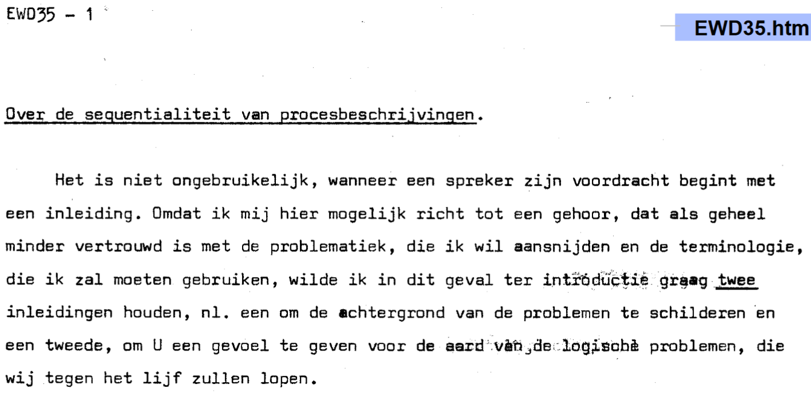

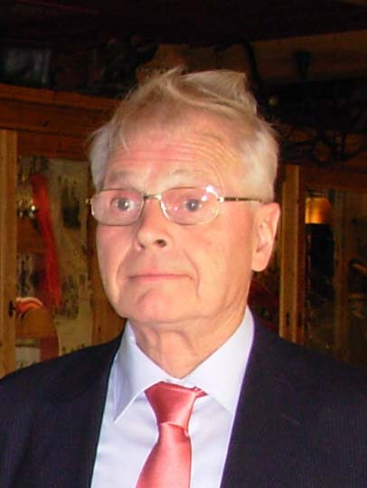
Mutual exclusion - Dekker’s solution
Theodorus (Dirk) J. Dekker
Notes:
1959

Slide 78
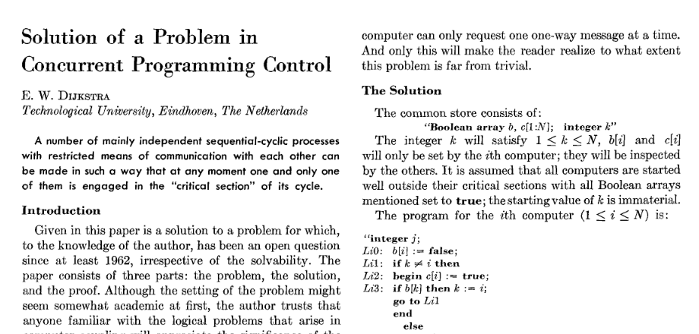
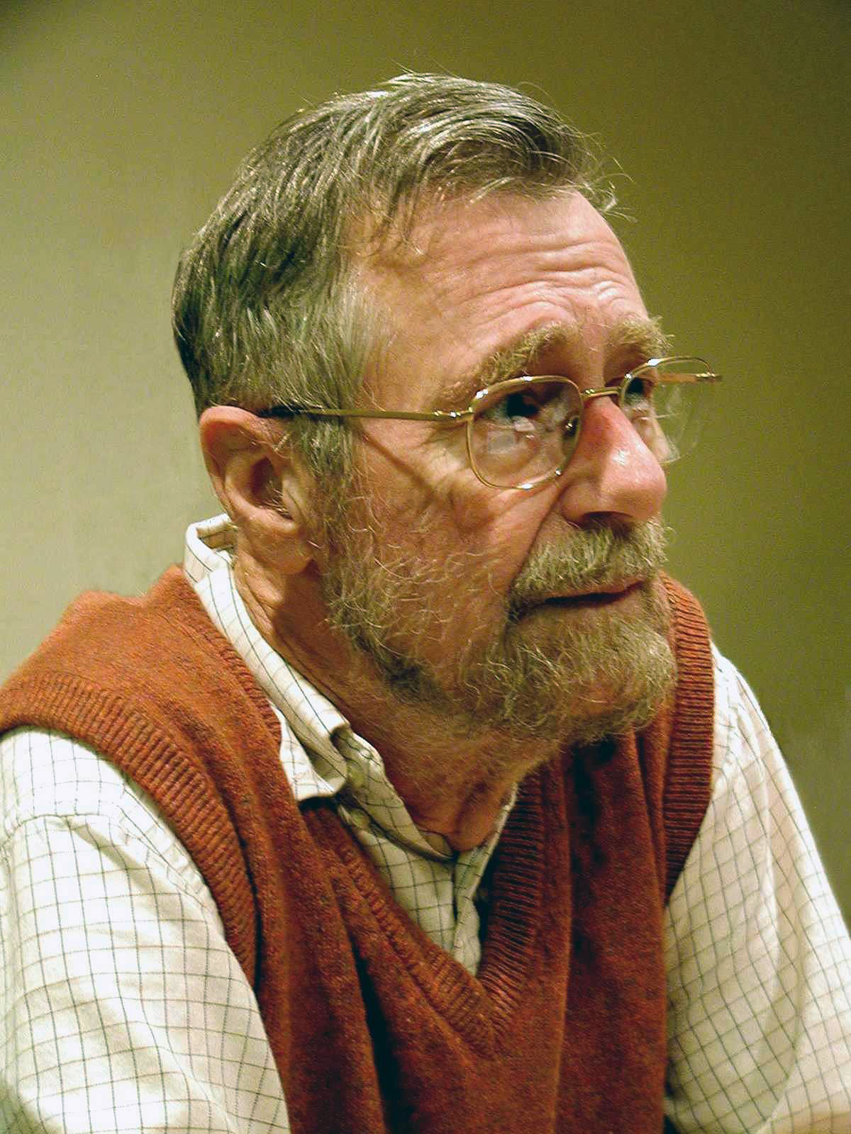
Mutual exclusion – Dijsktra’s Solution
Notes:
1962 – 1963
It works with multiple computers.
http://www.cs.utexas.edu/users/EWD/index01xx.html

Slide 79
Dekker’s Solution
wants_to_enter[0] = true
while wants_to_enter[1] {
if turn != 0 {
wants_to_enter[0] = false
while turn != 0 { // busy wait } wants_to_enter[0] = true
}
}
// critical section ...
turn = 1
wants_to_enter[0] = false

Slide 80
Dijsktra’s Solution
b[i] = fals
while(sw[i]) {
sw[i] = F
if (k!=i) {
c[i] = true
if(b[k])
k = i
sw[i] = T
} else {
c[i] = false
for(j=0;j<N;j++)
if(j!=i && !c[j])
sw[i] = T
}
}
//critical
b[i] = true
c[i] = true
lock()
unlock()

Slide 81
Peterson’s Solution
flag[0] =
;
flag[0] =
;
flag[0] = true;
P0_gate: turn = 1;
while (flag[1] == && turn == 1) { // busy wait }
// critical section ...
flag[0] = false;

Slide 82
Hardware assisted Solution
while (test_and_set(lock));
// critical section
lock = 0

Slide 83
Race condition - solution
a = 0
Thread 1
Thread 2
lock(locka)
load(a, eax)
eax = eax + 2
write(a, eax)
unlock(locka)
lock(locka)
load(a, eax)
eax = eax + 2
write(a, eax)
unlock(locka)
eax = 0
eax = 0

Slide 84
Race condition - solution
?
a = 0
Thread 1
Thread 2
lock(locka)
load(a, eax)
eax = eax + 2
write(a, eax)
unlock(locka)
lock(locka)
load(a, eax)
eax = eax + 2
write(a, eax)
unlock(locka)
eax = 0
eax = 2

Slide 85
Race condition - solution
OK
a = 0
Thread 1
Thread 2
lock(locka)
load(a, eax)
eax = eax + 2
write(a, eax)
unlock(locka)
lock(locka)
load(a, eax)
eax = eax + 2
write(a, eax)
unlock(locka)
eax = 0
eax = 2

Slide 86
Race condition - solution
?
a = 2
Thread 1
Thread 2
lock(locka)
load(a, eax)
eax = eax + 2
write(a, eax)
unlock(locka)
lock(locka)
load(a, eax)
eax = eax + 2
write(a, eax)
unlock(locka)
eax = 0
eax = 2

Slide 87
Race condition - solution
OK
a = 2
Thread 1
Thread 2
lock(locka)
load(a, eax)
eax = eax + 2
write(a, eax)
unlock(locka)
lock(locka)
load(a, eax)
eax = eax + 2
write(a, eax)
unlock(locka)
eax = 0
eax = 2

Slide 88
Race condition - solution
?
a = 0
Thread 1
Thread 2
lock(locka)
load(a, eax)
eax = eax + 2
write(a, eax)
unlock(locka)
lock(locka)
load(a, eax)
eax = eax + 2
write(a, eax)
unlock(locka)
eax = 2
eax = 0

Slide 89
Race condition - solution
OK
a = 0
Thread 1
Thread 2
lock(locka)
load(a, eax)
eax = eax + 2
write(a, eax)
unlock(locka)
lock(locka)
load(a, eax)
eax = eax + 2
write(a, eax)
unlock(locka)
eax = 2
eax = 0

Slide 90
Race condition - solution
?
a = 2
Thread 1
Thread 2
lock(locka)
load(a, eax)
eax = eax + 2
write(a, eax)
unlock(locka)
lock(locka)
load(a, eax)
eax = eax + 2
write(a, eax)
unlock(locka)
eax = 2
eax = 0

Slide 91
Race condition - solution
OK
a = 2
Thread 1
Thread 2
lock(locka)
load(a, eax)
eax = eax + 2
write(a, eax)
unlock(locka)
lock(locka)
load(a, eax)
eax = eax + 2
write(a, eax)
unlock(locka)
eax = 2
eax = 0

Slide 92
Race condition - solution
?
a = 4
Thread 1
Thread 2
lock(locka)
load(a, eax)
eax = eax + 2
write(a, eax)
unlock(locka)
lock(locka)
load(a, eax)
eax = eax + 2
write(a, eax)
unlock(locka)
eax = 2
eax = 2

Slide 93
Race condition - solution
OK
a = 4
Thread 1
Thread 2
lock(locka)
load(a, eax)
eax = eax + 2
write(a, eax)
unlock(locka)
lock(locka)
load(a, eax)
eax = eax + 2
write(a, eax)
unlock(locka)
eax = 2
eax = 2

Slide 94
Race condition - solution
?
a = 0
Thread 1
Thread 2
lock(locka)
load(a, eax)
eax = eax + 2
write(a, eax)
unlock(locka)
lock(locka)
load(a, eax)
eax = eax + 2
write(a, eax)
unlock(locka)
eax = 0
eax = 2

Slide 95
Race condition - solution
a = 0
Thread 1
Thread 2
IMPOSSIBLE
lock(locka)
load(a, eax)
eax = eax + 2
write(a, eax)
unlock(locka)
lock(locka)
load(a, eax)
eax = eax + 2
write(a, eax)
unlock(locka)
eax = 0
eax = 2

Slide 96
Mutex Pthread
ÎN MAIN
Înainte de a porni thread-urile
pthread_mutex_t mutex;
pthread_mutex_init(&mutex, NULL);

Slide 97
Mutex Pthread
pthread_mutex_t mutex;
pthread_mutex_init(&mutex, NULL);
Poate fi folosit să anunțe că acest mutex e împărțit mai multor procese

Slide 98
Mutex Pthread
pthread_mutex_lock(&mutex); load(a, eax)
eax = eax + 2
write(a, eax)
pthread_mutex_unlock(&mutex);

Slide 99
Mutex Pthread
ÎN MAIN
După ce au terminat thread-urile
pthread_mutex_destroy(&mutex);

Slide 101
Semaphore
ÎN MAIN
Înainte de a porni thread-urile
sem_t semaphore;
int semaphore_value= 4;
sem_init(& semaphore, 0, semaphore_value);

Slide 102


Semaphore
4
sem_wait(&semaphore);
P() sau Proberen
- Dijsktra

Slide 103
Semaphore
4
sem_wait(&semaphore);

Slide 104
Semaphore
4
sem_wait(&semaphore);

Slide 105
Semaphore
3
sem_wait(&semaphore);

Slide 106
Semaphore
Nu contează că doua thread-uri au ajuns simultan la semafor, acesta este protejat, la fel ca un mutex.
2
sem_wait(&semaphore);

Slide 107
Semaphore
1
sem_wait(&semaphore);

Slide 108


Semaphore
0
sem_wait(&semaphore);

Slide 109
Semaphore
0
sem_wait(&semaphore);

Slide 110

Semaphore – A different way of thinking
Un semafor are un set de token-uri.
sem_wait(&semaphore);

Slide 111
Semaphore – A different way of thinking
sem_wait(&semaphore);

Slide 112
Semaphore – A different way of thinking
sem_wait(&semaphore);

Slide 113
Semaphore – A different way of thinking
sem_wait(&semaphore);

Slide 114
Semaphore – A different way of thinking
sem_wait(&semaphore);

Slide 115
Semaphore – Signaling
sem_wait(&semaphore);
-1
sem_post(&semaphore);
sem_post(&semaphore);
V() sau Verogen
- Dijsktra

Slide 116
Semaphore – Signaling
sem_wait(&semaphore);
-1
sem_post(&semaphore);
sem_post(&semaphore);

Slide 117
Semaphore – Signaling
sem_wait(&semaphore);
-1
sem_post(&semaphore);
sem_post(&semaphore);

Slide 118
Semaphore – Signaling
sem_wait(&semaphore);
0
sem_post(&semaphore);
sem_post(&semaphore);

Slide 119
Semaphore – Signaling
sem_wait(&semaphore);
1
sem_post(&semaphore);
sem_post(&semaphore);

Slide 120
Semaphore – Signaling
sem_wait(&semaphore);
0
sem_post(&semaphore);
sem_post(&semaphore);

Slide 121
Semaphore
ÎN MAIN
După ce au terminat thread-urile
sem_destroy(& semaphore);

Slide 122
Barrier

Slide 123
Barrier
ÎN MAIN
Înainte de a porni thread-urile
pthread_barrier_t barrier;
int num_threads = 5;
pthread_barrier_init(&barrier, NULL, num_threads);

Slide 124
Barrier
pthread_barrier_wait(&barrier);
5

Slide 125
Barrier
pthread_barrier_wait(&barrier);
5
For all threads, all code here
is executed before any code here

Slide 126
Barrier
pthread_barrier_wait(&barrier);
5

Slide 127
Barrier
pthread_barrier_wait(&barrier);
5

Slide 128
Barrier
pthread_barrier_wait(&barrier);
5

Slide 129
Barrier
pthread_barrier_wait(&barrier);
3

Slide 130
Barrier
pthread_barrier_wait(&barrier);
2

Slide 131
Barrier
pthread_barrier_wait(&barrier);
1

Slide 132
Barrier
pthread_barrier_wait(&barrier);
1

Slide 133
Barrier
pthread_barrier_wait(&barrier);
1

Slide 134
Barrier
pthread_barrier_wait(&barrier);
1

Slide 135
Barrier
pthread_barrier_wait(&barrier);
0

Slide 136
Barrier
pthread_barrier_wait(&barrier);
0

Slide 137

Barrier
Cum știe o barieră când să se reseteze?
O soluție ar fi:
Reusable Barrier in
The Little Book of Semaphores
By Allen B. Downey
pthread_barrier_wait(&barrier);
5

Slide 138
Barrier
ÎN MAIN
După ce au terminat thread-urile
pthread_barrier_destroy(&barrier);

Slide 140
Some problems can not be parallelized
Calculating the hash of a hash of a hash …
of a string.
Deep First Search
Huffman decoding
Outer loops of most simulations
P complete problems

Slide 141
Splitting a problem to make it parallel
Sunt o serie de probleme care sunt extrem de ușor paralelizabile.
Embarrassingly parallel

Slide 142
Embarrassingly parallel problems
Multiplicare unui vector cu un scalar
9
6
9
4
2
7
6
5
6
1
* 3
27
18
27
12
6
21
18
15
18
3

Slide 143
Embarrassingly parallel problems
Toate calculele pot fi efectuate în același timp
9
6
9
4
2
7
6
5
6
1
* 3
27
18
27
12
6
21
18
15
18
3

Slide 144
Embarrassingly parallel problems
Câte elemente sunt?
9
6
9
4
2
7
6
5
6
1

Slide 145
Embarrassingly parallel problems
Câte elemente sunt?
…
9
6
9
4
2
7
6
5
6
1

Slide 146
Embarrassingly parallel problems
Câte elemente sunt? N
…
9
6
9
4
2
7
6
5
6
1

Slide 147
Embarrassingly parallel problems
Dar câte elemente de procesare?
…
9
6
9
4
2
7
6
5
6
1

Slide 148
Embarrassingly parallel problems
Dar câte elemente de procesare? P
…
9
6
9
4
2
7
6
5
6
1

Slide 149
Embarrassingly parallel problems
Dar câte thread-uri?
…
9
6
9
4
2
7
6
5
6
1

Slide 150
Embarrassingly parallel problems
Dar câte thread-uri? P
…
9
6
9
4
2
7
6
5
6
1
În majoritatea cazurilor obținem performanță maximă când numărul de thread-uri este egal cu numărul de elemente de procesare, sau core-uri.

Slide 151
Embarrassingly parallel problems
Cum este P față de N?
…
9
6
9
4
2
7
6
5
6
1

Slide 152
Embarrassingly parallel problems
P << N
…
9
6
9
4
2
7
6
5
6
1

Slide 153
Embarrassingly parallel problems
Caz concret: P = 2
Cum împărțim?
…
9
6
9
4
2
7
6
5
6
1

Slide 154
Embarrassingly parallel problems
Caz concret: P = 2
Cum împărțim?
…
9
6
9
4
2
7
6
5
6
1
Thread 1
Thread 2

Slide 155
Embarrassingly parallel problems
Caz concret: P = 2
Cum împărțim?
…
9
6
9
4
2
7
6
5
6
1
Thread 1
Thread 2

Slide 156
Embarrassingly parallel problems
Caz concret: P = 2
Cum împărțim?
…
9
6
9
4
2
7
6
5
6
1
Thread 1
Thread 2

Slide 157
Embarrassingly parallel problems
Caz concret: P = 2
Cum împărțim? Putem și random
…
9
6
9
4
2
7
6
5
6
1
Thread 1
Thread 2

Slide 158
Embarrassingly parallel problems
Caz concret: P = 2
Cum împărțim?
…
9
6
9
4
2
7
6
5
6
1
Thread 1
Thread 2

Slide 159
Embarrassingly parallel problems
Caz concret: P = 2
Cum împărțim?
Este utilă?
…
9
6
9
4
2
7
6
5
6
1
Thread 1
Thread 2

Slide 160
Embarrassingly parallel problems
Caz concret: P = 2
Cum împărțim?
Ce ne dorim?
…
9
6
9
4
2
7
6
5
6
1
Thread 1
Thread 2

Slide 161
Embarrassingly parallel problems
Caz concret: P = 2
Cum împărțim?
Ce ne dorim?
Aproximativ același număr elemente
…
9
6
9
4
2
7
6
5
6
1
Thread 1
Thread 2

Slide 162
Embarrassingly parallel problems
Aproximativ N/P elemente
…
9
6
9
4
2
7
6
5
6
1
Thread 1
Thread 2

Slide 163
Embarrassingly parallel problems
Aproximativ N/P elemente
Dacă N nu se divide perfect la P?
…
9
6
9
4
2
7
6
5
6
1
Thread 1
Thread 2

Slide 164
Embarrassingly parallel problems
Aproximativ N/P elemente
Dacă N nu se divide perfect la P?
1
6
8
4
2
7
4
9
2
9
6
9
5
6
3
Thread 1
Thread 2

Slide 165
Embarrassingly parallel problems
floor(N/P) elemente floor(15/2) = 7
1
6
8
4
2
7
4
9
2
9
6
9
5
6
3
Thread 1
Thread 2

Slide 166
Embarrassingly parallel problems
ceil(N/P) elemente ceil(15/2) = 8
6
5
8
1
4
2
7
4
9
2
9
6
9
6
3
Thread 1
Thread 2

Slide 167
Embarrassingly parallel problems
A = floor(N/P)
PA
0
A
2A
N

Slide 168
Embarrassingly parallel problems
A = ceil(N/P)
PA
0
A
2A
N

Slide 169
Embarrassingly parallel problems
Formule elegante:
Tid este identificator de thread, are valori de la 0 la P
start = Tid * ceil(N/P)
end = min(N, (Tid+1) * ceil(N/P))
PA
0
A
2A
N

